Slide 1
Note to presenter
Thank you for participating in the When I’m 65 program and for working to make sure everyone has the information they need to plan for a secure and fulfilling retirement.
This slide set was developed as part of the When I’m 65 program and is designed to be used with the “Getting Closer to Retirement” booklet and the When I’m 65 documentary and complementary video as part of an investor education course or other educational event, curriculum or course of study.
The content is designed to educate adults ages 55–70 who are approaching retirement age and looking to boost the longevity of their nest egg, determine their guaranteed retirement income and preserve their savings. The target audience also includes individuals exploring supplemental retirement-income options such as an encore career, starting a new business, part-time employment as part of a phased retirement and continued education in their later years.
When I’m 65 offers a lot of great video that you can download and include with this presentation including the full documentary. Go to www.wi65.org/video and click on “Information for Baby Boomers.”
The When I’m 65 materials are all independent, unbiased, noncommercial and for educational use only. Facilitators/presenters are prohibited from selling financial or investing products or services as part of the When I’m 65 program.
Delete this slide before the presentation.

Slide 2
SECURING YOUR FUTURE PAYCHECK 6 STEPS YOU CAN TAKE TODAY

Slide 3
The When I’m 65 program
How we live & thrive in retirement is changing dramatically
The When I’m 65 program is a national public television documentary and a multi-year community engagement program.
The When I’m 65 documentary explores:
Multi-generational approaches to retirement
Changing attitudes toward work, debt, housing, and financial fraud
Financial choices Americans of all ages must make to plan for a financially secure future
The When I’m 65 community engagement program uses screenings of the documentary, engagement videos, booklets, in-person training, and other resources to stimulate discussions and online activity to help individuals and families prepare for a financially secure retirement.
www.wi65.org | facebook.com/WI65Project | twitter.com/WI65Project

Slide 4
When I’m 65 program partners
The When I’m 65 documentary and community engagement program is made possible by:
The Investor Protection Trust (IPT) is a nonprofit organization devoted to investor education. Since 1993, the Investor Protection Trust has worked with the states and at the national level to provide the independent, objective investor education needed by all Americans to make informed investment decisions. www.investorprotection.org | facebook.com/InvestorProtectionTrust | twitter.com/IPT_Info
The Investor Protection Institute (IPI) is an independent nonprofit organization that advances investor protection by conducting and supporting unbiased research and groundbreaking education programs. www.iInvest.org | facebook.com/InvestorProtectionInstitute | twitter.com/IPI-News
Detroit Public Television is a viewer-supported PBS member station located in Wixom, Michigan. Their vision is for a community in which people trust public media to help them discover new ideas, make informed decisions and enjoy enriched lives. The station is notably active in producing programs that showcase arts, culture, news and analysis; and educational outreach campaigns that use the power of media to provide knowledge and understanding.
www.dptv.org | facebook.com/detroitpublictv | twitter.com/detroitpublictv

Slide 5
Introduction
As you approach retirement age, your dreams for life’s next chapter are coming into view.
You can’t afford to lose sight of an important goal: boosting your nest egg’s longevity.
Now’s the time to size up your future income, preserve savings, and consider supplemental retirement-income options.
Each move you make will go toward supporting the retirement you deserve.

Slide 6
6 steps to take today
Shift investing and withdrawal strategies.
Get trustworthy advice to stay on track.
Plan for Social Security and Medicare.
Understand the pros and cons of annuities.
Get more value from your home equity.
Explore a phased retirement.
Let’s take a closer look at the six steps.

Slide 7
Step 1: Shift investing and withdrawal strategies
REALLOCATE YOUR ASSET MIX
Shift from growth to wealth preservation as retirement nears.
Bump up share of safer investments (bonds and cash) vs. riskier investments (stocks).
Keep a healthy portion of higher-return investments (such as more stable income stocks) to sustain your nest egg.
Common rule of thumb: Set an allocation for stocks by subtracting your age from 120.
Example: At age 60, your portfolio would hold 60% stocks and 40% bonds.

Slide 8
Shift investing and withdrawal strategies
Consider target date funds
To simplify portfolio management, consider transferring retirement investments into this type of mutual fund, based on the approximate year you plan to retire.
Automatically adjusts toward more conservative investments as target date approaches.
Designed to be the only investment in your retirement portfolio; holding other funds defeats their purpose.
Know whether it’s a “to” fund or a “through” fund.
“To” funds aim to reach their most conservative portfolio mix on the target date.
“Through” funds won’t hit that final portfolio until after the target date, taking fund holders through retirement.

Slide 9
Shift investing and withdrawal strategies
Continue to stash the maximum in your retirement accounts by using special tax-advantaged “catch up” contributions.
Alert: The IRS may change annual limits; find the current year’s limits at: www.irs.gov/retirement-plans/plan-participant-employee/retirement-topics-contributions
The IRS facts on catch-up contributions:
In employer plans, like 401(k) and 403(b) plans, you can contribute an extra $6,000, bringing the maximum total annual contribution to $24,500 for 2018.
For Roth and traditional IRAs, you can contribute an extra $1,000, for a total annual contribution of $6,500 for 2018.

Slide 10
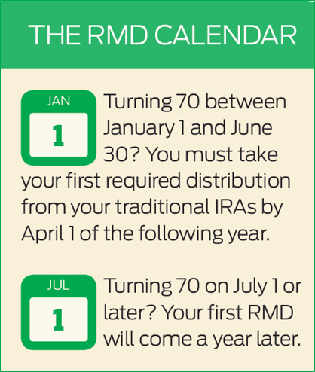
Minimize tax impact of withdrawals
When you withdraw money from retirement accounts, or start receiving pension payments, income taxes come into play.
To minimize that tax bite, time withdrawals strategically.
First up? Required minimum distributions, or RMDs, from taxable retirement accounts.

Slide 11
Shift investing and withdrawal strategies
FOLLOW THESE STEPS, IN ORDER
First, take all RMDs for traditional IRAs and 401(k) plans to avoid an IRS penalty (50% of the amount you failed to withdraw).
Second, take withdrawals from any taxable accounts to dodge additional taxable income.
Third, take withdrawals from tax-deferred and tax-free accounts last. The idea is to draw down these funds only when the combination of RMDs and taxable account withdrawals falls short of your monthly expenses.

Slide 12
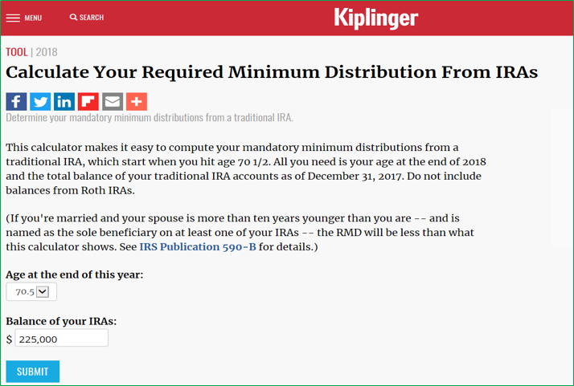
ACTION STEP
Calculate your RMDs with these tools:
www.irs.gov/retirement-plans/plan-participant-employee/required-minimum-distribution-worksheets
www.aarp.org/work/retirement-planning/required_minimuum_distribution_calculator.html
www.kiplinger.com/tool/retirement/T032-S000-minimum-ira-distribution-calculator-what-is-my-min/index.php

Slide 13
Step 2: Get trustworthy advice to stay on track
Financial planning can get more complex the closer you get to retirement. You may need some trusted, professional guidance.
A financial adviser can help you:
Shift toward a wealth preservation strategy.
Pull money out of retirement accounts in a tax-wise way.
Create a sustainable budget.
Manage and organize financial accounts and documents.
Plan for the possibility of long-term care.

Slide 14
Get trustworthy advice to stay on track
Look for a fiduciary
Fiduciary professionals put you first and avoid conflicts of interest.
They can help align your financial plan with retirement goals.
They work for fee-based compensation.
FIND A GOOD MATCH
Check out descriptions for some common adviser credentials, such as CFP® or CFA®, at www.fma.org/finance-certifications
Find detailed explanations for how these and other professionals work, in the booklet Getting Help With Your Investments, from the Investor Protection Trust, at www.investorprotection.org/downloads/IPT_Getting_Help_2015.pdf

Slide 15
Get trustworthy advice to stay on track
CONSIDER LESS COSTLY ‘HYBRIDS’
Combination of computer-generated “robo” services with periodic guidance from a financial professional.
May be best for managing money you won’t be using for 10 to 25 years.
Many traditional adviser networks and big brokerage firms now offer this fast-growing alternative.
Keep in mind: You may not be able to develop an ongoing relationship with a dedicated adviser.

Slide 16
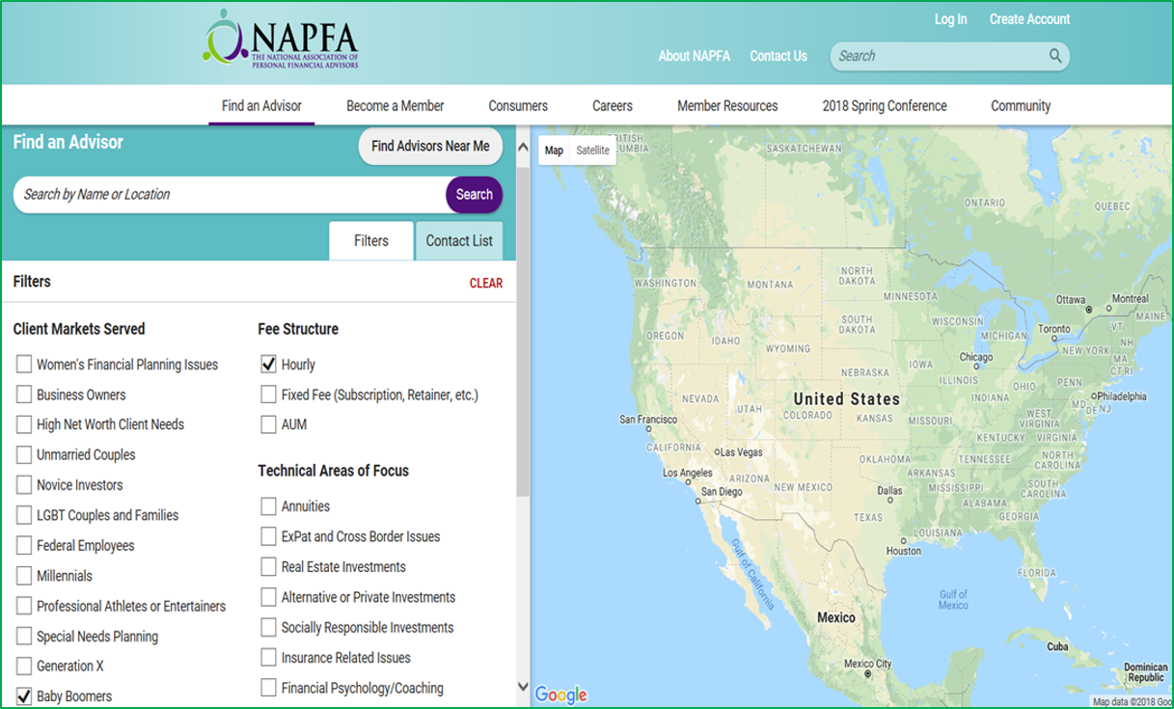
ACTION STEPS
Find a fee-only adviser
The National Association of Personal Financial Advisors offers a search tool to identify fee-only professionals meeting your criteria at:
www.napfa.org/find-an-advisor#tab=filters
Verify a specific adviser
Your State Securities Regulator can confirm an adviser’s licensing and education. Find them on the North American Securities Administrators Association website at:
www.nasaa.org/2709/how-to-check-out-your-broker-or-investment-adviser/
Investigate hybrid robo advisers
The Robo Report rates the largest services by performance in equity, fixed income, and total portfolio. Subscribe for free at:
www.theroboreport.com/

Slide 17
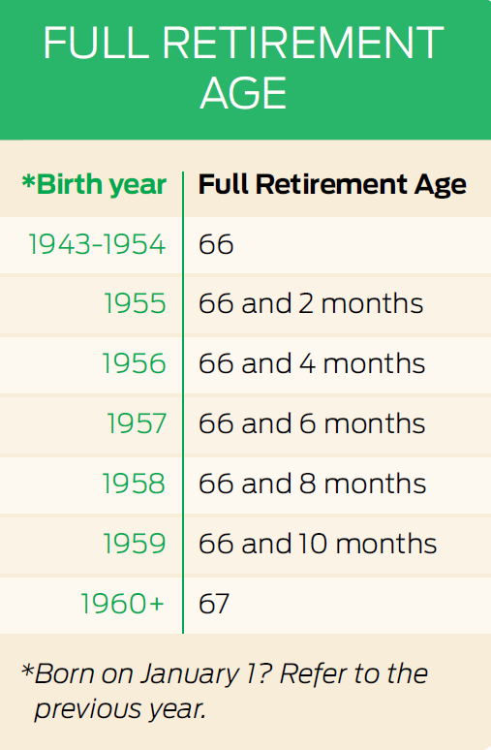
Step 3: Plan for Social Security and Medicare
TIME YOUR SOCIAL SECURITY CLAIM RIGHT
Longer lifespans mean there’s a good chance your retirement could last 30 or more years.
That makes the decision about when to start collecting Social Security even more important.
You can claim benefits anytime between age 62 and age 70.
Age at which you can claim a full benefit (your Full Retirement Age) is based on the year you were born.

Slide 18
Plan for Social Security and Medicare
Start collecting Social Security before full retirement age:
Collect benefits longer, but receive a reduced amount – about 6% less each year.
Wait to claim Social Security until after full retirement age:
Collect benefits for a shorter time, but get a higher payout, as much as 8% per year up to age 70.
Example: For someone whose full retirement age is 66, holding off until age 70 means receiving 32% more every year in retirement!
ELIMINATE GUESSWORK
To help with this critical decision, try these online calculators to uncover the most advantageous time to claim Social Security benefits:
Go to www.aarp.org or www.financialengines.com and search for “Social Security calculator.”

Slide 19
Plan for Social Security and Medicare
APPLY FOR MEDICARE
Part A:
At age 65, it’s time to sign up for Medicare Part A, which covers hospitalization costs.
Enroll even if you continue to work and are covered by an employer’s health insurance plan.
If you’re already receiving Social Security retirement benefits, you’ll be enrolled automatically.

Slide 20
Plan for Social Security and Medicare
APPLY FOR MEDICARE
Part B:
Retired? Then it’s also time to sign up for Medicare Part B, which covers doctor visits and outpatient services.
Part B’s initial enrollment period begins three months before your birthday month and ends three months after it.
Missing this seven-month window comes with consequences:
Premiums may go up by 10% for each 12-month period you could have had Part B but didn’t enroll. (Note: The penalty doesn’t apply if you’re still working and have health insurance through your employer).
You’ll have to wait until the next Part B general enrollment period, which runs from January 1 to March 31 each year, to sign up for benefits beginning the following July 1.

Slide 21
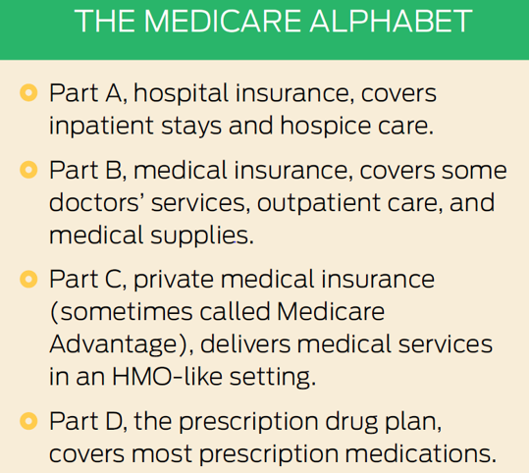
2 more considerations
Supplemental Medicare policies (often called Medigap insurance) through private insurers may cover deductibles and other holes in your Part A and Part B coverage.
Optional Medicare Part C and Part D coverage is available.

Slide 22
ACTION STEP
Create a “my Social Security” account at: www.ssa.gov/myaccount.
Review estimates of future benefits.
Verify your earnings record.
Apply for Medicare at: www.medicare.gov/.
Learn about the range of plans offered.

Slide 23
Step 4: Understand pros and cons of annuities
WHAT ARE ANNUITIES?
Income annuities. Work like a DIY pension plan. You pay an insurance company a lump sum in exchange for a guaranteed “paycheck” either for a set number of years or for the rest of your life.
3 types:
Immediate annuities: begin receiving distributions right away
Deferred annuities: delay receipt of distributions
Variable annuities: a type of deferred product
Invested in mutual fund-like accounts, the future income stream varies based on investment performance.

Slide 24
Understand pros and cons of annuities
CONSIDER THE PROS
Provide ongoing, predictable income with steady monthly ‘paychecks.’
Defer taxes on earnings until withdrawal.
Offer peace of mind and less complexity in managing investments during retirement.
TAKE NOTE OF THE CONS
You’ll pay a sales commission.
For variable annuities, you’ll also pay expenses associated with the underlying investments.
Immediate annuities are generally irrevocable; deferred annuities levy high surrender fees to ‘unlock’ your money.
Variable annuities are a leading source of investor complaints, including cases of fraudulent sales practices.

Slide 25
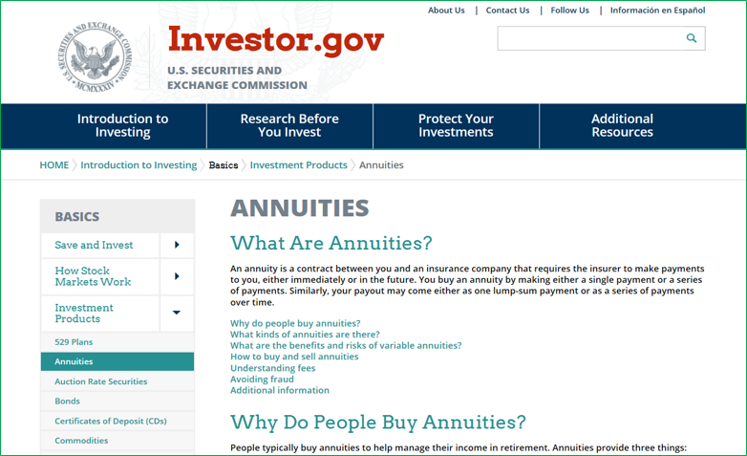
ACTION STEP
Learn much more about the risks and benefits of annuities with the resource, What Are Annuities?
Available from the U.S. Securities and Exchange Commission at:
www.investor.gov/introduction-investing/basics/investment-products/annuities

Slide 26
Step 5: Get more value from your home equity
Your home may be your biggest source of wealth.
Tapping into that equity can help fill in retirement-savings gaps.
Consider 3 ways to capitalize on your home’s value:
Downsize to smaller digs and sell the home at a gain.
Share an empty nest with friends or relatives for supplemental income.
Draw money from the house through a reverse mortgage.

Slide 27
Get more value from your home equity
DOWNSIZING
You might realize a considerable price appreciation gain.
A smaller home also means lower property taxes, insurance, upkeep, and utilities.
Such a move frees up extra money for retirement, which can be used to cover expenses or to bolster savings.

Slide 28
Get more value from your home equity
SHARING
Communal living is making a comeback in the form of home sharing.
Under carefully outlined and agreed-upon expectations, shared housing could provide you with greater supplemental income than if you lived alone.
Added benefits include social companionship, security, and mutual support.

Slide 29
Get more value from your home equity
REVERSE MORTGAGES
Available to homeowners age 62 and over.
Formally known as home equity conversion mortgages, or HECMs, they are federally insured.
You borrow against the equity in your home, but don’t have to repay the loan or the interest on it until you leave the house.
Typically set up either as a line of credit, fixed monthly payments, or a combination of the two.
Accessible yet complex products, so understanding the benefits and drawbacks is essential.

Slide 30
Get more value from your home equity
ASSESS THE BENEFITS
Pay off a mortgage and other debts.
Cover ongoing living expenses, either now or down the road.
Provide a reserve for medical or care expenses.
WEIGH THE DRAWBACKS
Fees and closing costs can be steep.
Those costs could impact your home’s value and ultimately your long-term equity.
Some reverse mortgages require full loan payback if you move out of your house for more than a year.

Slide 31
ACTION STEPS
Talk with an HECM counselor. You must meet with a government-approved professional before applying for an HECM loan.
Find a counselor by using the FHA’s search tool, available at: https://entp.hud.gov/idapp/html/hecm_agency_look.cfm
Explore home-sharing resources by state at: http://nationalsharedhousing.org

Slide 32
Step 6: Consider a phased retirement
3 reasons to consider
A fatter nest egg. While you’re working, you can keep feeding your retirement accounts and benefit from tax-deferred growth.
A bigger pension. You may get a bigger payout by working a few more years. Note: Pension formulas often more heavily weight earnings during the final years of employment, so investigate how a reduced salary for the last few years of employment would affect your benefit.
A heftier Social Security check. While you’re still earning, it’s more likely you can afford to delay claiming Social Security to maximize your benefit in later years.
WHAT IS PHASED RETIREMENT?
A type of flexible work arrangement that allows for a reduced work schedule over a period of time as a gradual transition to full retirement.

Slide 33
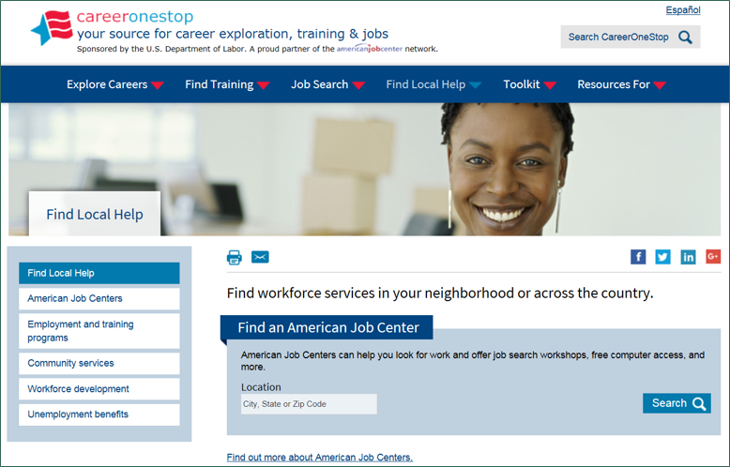
ACTION STEP
Learn more about phased retirement by tapping these resources:
Jobs-in-retirement resources at AARP’s “Working at 50+” portal, available at: www.aarp.org/work/working-at-50-plus/
Workforce services in your area at American Jobs Centers, available at: www.careeronestop.org/LocalHelp/local-help.aspx

Slide 34
Quiz: Test your retirement know-how
Now that you’ve discovered more about making your nest egg last, you’re ready to begin a new chapter, whenever that makes sense for you.
Let’s put your planning skills to the test with these six questions!

Slide 35
Quiz: Test your retirement know-how
QUESTION # 1
As you’re sizing up the retirement income and savings you’re building, about how many years may that nest egg need to last?
A 10 to 15 years
B 15 to 20 years
C 20 to 30 years

Slide 36
Quiz: Test your retirement know-how
THE ANSWER?
Plan to fund a long life in retirement. The best answer is C, 20 to 30 years.
Today’s increasing life expectancies for both men and women mean you could easily spend two to three decades or more in retirement. One out of every four 65-year-olds today will live past age 90, and one out of 10 will live past age 95, according to actuarial data from the Social Security Administration.
That’s why it’s important to take the right steps toward securing that nest egg’s longevity.

Slide 37
Quiz: Test your retirement know-how
QUESTION # 2
To minimize the tax bite, which accounts should you consider tapping first when withdrawing from your portfolio?
Rank your choices by order of priority.
Taxable accounts
Tax-advantaged accounts
Accounts subject to Required Minimum Distributions (RMDs)

Slide 38
Quiz: Test your retirement know-how
THE ANSWER?
Consider withdrawing money from your retirement portfolio in this order to lessen the tax impact:
Take your RMDs from tax-deferred accounts like IRAs and 401(k)s (if you’ve reached the trigger point of age 70½).
Taxable accounts come second. Since you pay taxes on the earnings in savings and investment accounts every year anyway, it makes sense to withdraw from them next. That way, you won’t be accumulating any additional taxable income.
Tax-advantaged accounts are last. Try to tap these funds only when the combination of RMDs and taxable account withdrawals isn’t enough to cover your monthly expenses.

Slide 39
Quiz: Test your retirement know-how
QUESTION # 3
True or false?
You should wait until you retire to shift your investments to a more conservative asset allocation.
True
False

Slide 40
Quiz: Test your retirement know-how
THE ANSWER?
False. You should gradually shift your investments to a more conservative asset mix before you retire.
That doesn’t mean you should shun all growth-focused investments. You’ll want to keep some higher-return investments (such as more stable income stocks) in your portfolio to plump up your nest egg over the long term.
Another option? Transfer retirement investments into a target date fund (with the target date based on the year you plan to retire). These funds do the rebalancing for you – automatically modifying holdings toward a more conservative mix the closer you get to retirement.

Slide 41
Quiz: Test your retirement know-how
QUESTION # 4
What does Medicare Part A cover?
Doctor bills
Prescription medicines
Hospitalization costs
All of the above
A
B
C
D

Slide 42
Quiz: Test your retirement know-how
THE ANSWER?
It’s C. Medicare Part A, in which you should enroll when you turn 65, covers hospitalization, including inpatient stays and hospice care. Medicare Part B covers doctor visits and outpatient services. And Medicare Part D covers prescription drugs.
There’s no charge for Medicare Part A. And for most beneficiaries, Part B costs $134 per month in 2018. The monthly charges for Medicare Part B depend on your income.
There’s also the option to purchase Medicare Part C (Medicare Advantage) and Part D (prescription drug coverage). Each part comes with its own co-pays and deductibles.

Slide 43
Quiz: Test your retirement know-how
QUESTION # 5
Which of these questions should you weigh when considering whether an annuity makes sense?
Will I need to generate more predictable income in retirement to cover essentials?
Do I already have a hefty, diversified nest egg?
What happens if I need to access my money before the withdrawal period begins?
How healthy is the insurer selling the annuity?
All of the above.
A
B
C
D
E

Slide 44
Quiz: Test your retirement know-how
THE ANSWER?
E, all of the above. Annuities can be complex products, so it’s important to do your homework if you’re considering adding them to your retirement income plan.
On one hand, annuities can offer peace of mind by providing predictable, guaranteed income. Some people look to annuities to “insure” their retirement and to receive periodic payments once they no longer receive a salary.
On the other hand, if you have (or are confident you will have) a sizable nest egg made up of a pension, or IRAs, 401(k)s and other investment accounts that you’re unlikely to deplete in your lifetime, annuities may not offer any added benefit.
All investments carry a level of risk, of course, and annuities come with fees and charges for certain features. And always make sure you consider the financial strength of the insurance company issuing any annuity you’re researching.

Slide 45
Quiz: Test your retirement know-how
QUESTION # 6
Which of these statements about reverse mortgages is false?
A reverse mortgage is a loan secured by the value of a home (your primary residence).
Reverse mortgage holders aren’t responsible for paying property taxes or homeowners insurance anymore, as a condition of the loan.
Borrowers can choose to receive their loan proceeds as a monthly payment, a line of credit, or a combination of these.
A
B
C

Slide 46
Quiz: Test your retirement know-how
THE ANSWER?
It’s B. With a typical mortgage, monthly payments often include escrows for property taxes and homeowners insurance. But with a reverse mortgage, the borrower is responsible for making those payments, as well as for paying homeowners association dues and other assessments.
Because it’s a condition of the loan that’s specified in the mortgage note, failing to make these payments as required can lead to the loan being placed into default.

Slide 47
Quiz: Test your retirement know-how
QUESTION # 7
Jot down two reasons why exploring a phased retirement might benefit you.
Hint: Yes, they both have to do with money.
Reason #1:
Reason #2:

Slide 48
Quiz: Test your retirement know-how
THE ANSWER?
Reason #1: You’ll wind up with a fatter nest egg.
While you’re still working, you’ll delay drawing down savings. And even if you don’t add a penny, the money in your retirement accounts will continue to benefit from tax-deferred growth.
Reason #2: You’ll get a bigger Social Security check.
Remember, monthly payments rise by 8% for each year you delay taking benefits after your full retirement age. So while you’re still bringing home the bacon, it’s more likely you can delay claiming Social Security to maximize that benefit.

Slide 49
Contact information
Presenter’s contact information
Investor Protection Trust www.investorprotection.org

